Slide 1


Filecoin - A Blockchain Based Distributed Storage System
Presented by Rishabh Shenoy
Submitted to Prof. Sudhir Dhage
Date: September 15 , 2025

Slide 2

What are Blockchain Based Distributed Storage Systems?
Blockchain-based Distributed Storage Systems leverage decentralized networks to store data, fundamentally changing how information is managed compared to traditional centralized models.
Centralized Storage Systems
Architecture: Data resides on a few central servers managed by a single entity.
Vulnerabilities: Susceptible to single points of failure, censorship, and data breaches.
Blockchain-Based Distributed Storage Systems
Architecture: Data is fragmented, encrypted, and distributed across a network of independent nodes (peers).
Server Terms: Operates on a peer-to-peer network; each node acts as a mini-server, contributing to a distributed ledger.
Advantages: Enhanced security, censorship resistance, and data redundancy due to cryptographic proofs and network consensus.

Slide 3

Genesis of Decentralized Storage
From Data Deluge to Distributed Solutions
The exponential growth of data has strained traditional centralized storage models, leading to significant vulnerabilities and inefficiencies.
Single points of failure
High costs and limited scalability
Censorship and control by large corporations
Limited scalability under massive demand
Censorship and corporate control over data
Privacy risks & vulnerability to breaches
Vendor lock-in reduces flexibility for users
Lack of transparency in storage guarantees
High infrastructure & maintenance costs
The emergence of P2P networks and blockchain technology provided a new paradigm, enabling secure and distributed systems. Filecoin was conceived to decentralize data storage, mirroring the success of Bitcoin's decentralized finance.

Slide 4
Filecoin Overview
The Decentralized Storage Revolution
Filecoin addresses the limitations of centralized data storage by creating a decentralized, verifiable, and incentivized network. It transforms cloud storage into an algorithmic market, powered by blockchain technology.
Problem Solved
Filecoin's Solution
Significance
Reliance on centralized providers, data breaches, vendor lock-in, and censorship risks.
A global network where anyone can store or retrieve data securely and verifiably.
Foundation for Web3, enabling censorship-resistant and resilient data storage.
Scalability
Global Participation
Economic Security
Exabyte-scale distributed storage network.
Dynamic market balances supply & demand. Open to individuals & enterprises.
Rewards honest storage, penalizes faults , Flexible contracts with transparency

Slide 5






Pillars of Filecoin
Core Principles
Openness
Incentive Engineering
Permissionless network, accessible to all.
FIL token rewards for storage, penalties for non-compliance.
Cryptographic Proofs
Scalability & Security
PoRep (Proof-of-Replication) and PoSt (Proof-of-Spacetime) ensure data integrity and availability.
Designed for petabytes of data with inherent blockchain security.
Privacy & Confidentiality
Market & Coordination Layer
End-to-end encryption ensures miners cannot access plaintext data. Zero-knowledge proofs (zk-SNARKs) protect sensitive information.
Transparent storage and retrieval markets enable fair price discovery.

Slide 6



Architecture of Filecoin:
Filecoin's robust architecture is built upon a layered system, ensuring decentralized, verifiable, and efficient data storage.
Data Storage Layer
Blockchain & Consensus Layer
Storage & Retrieval Market Layer
This foundational layer comprises Storage Miners who provide raw storage capacity. They seal client data into sectors and maintain its availability over time, constantly proving storage to the network through cryptographic proofs.
The heart of Filecoin, this layer is built on a custom blockchain that records all deals, validates proofs (Proof-of-Replication and Proof-of-Spacetime), and manages the network's state. It ensures transparency, immutability, and security across the system.
This layer facilitates the interaction between Clients and miners. It's a dynamic marketplace where clients can find storage providers, negotiate deals, and retrieve data. Retrieval Miners specialize in delivering data quickly, fostering a competitive and efficient environment.

Slide 7
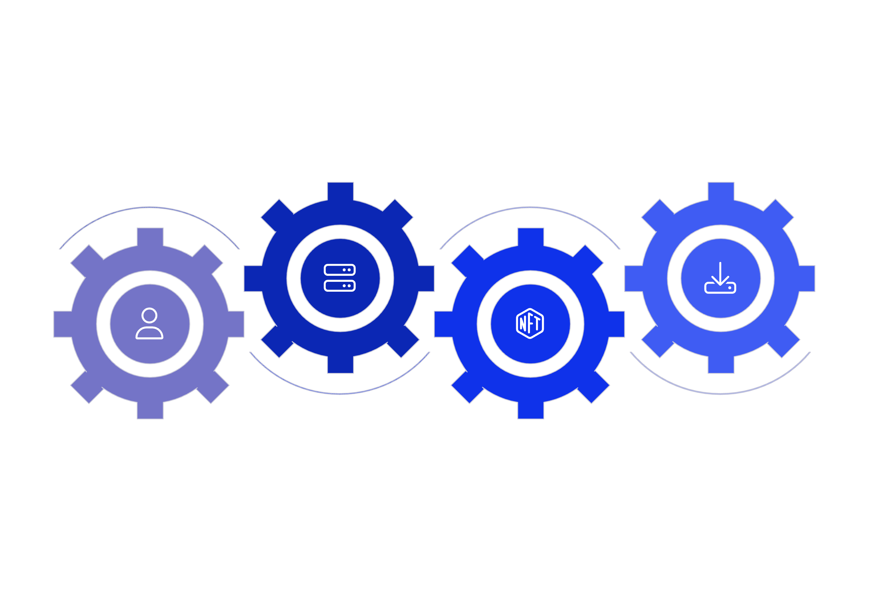




Network Structure
Filecoin Architecture
Storage Miners
Retrieval Miners
Store data and submit PoRep/PoSt proofs
Deliver requested data to clients
Clients
Blockchain
Request storage and retrieval services
Coordinates market, verifies proofs and deals

Slide 8
Interaction between Components in Filecoin: A Detailed Workflow
Filecoin's decentralized storage ecosystem operates through intricate interactions, ensuring data integrity, availability, and incentivized participation. This workflow outlines how clients, miners, and the blockchain collaborate from initial onboarding to ongoing data management and retrieval.
1
2
Onboarding & Role Commitment
Client Storage Request & Matching
Participants (Clients, Storage Miners, Retrieval Miners) join the network. Storage Miners pledge collateral (FIL) for storage space.
Clients submit bid orders for storage, and Storage Miners publish ask orders. The network autonomously matches compatible bids and asks.
3
4
Deal Confirmation & Data Movement
Sealing & Continuous Proofs
Client encrypts and sends data to the Storage Miner. Both cryptographically sign a deal, committing it to the blockchain and updating the AllocTable.
Storage Miners seal data using Proof-of-Replication (PoRep) and continuously submit Proof-of-Spacetime (PoSt) to demonstrate ongoing storage.
5
6
Network Verification & Incentives
Client-Side Retrieval Process
The network validates all proofs. Missing or invalid proofs lead to penalties on miner collateral and trigger fault-repair mechanisms.
Clients submit retrieval bids. Retrieval Miners respond, and a micropayment channel is established for efficient, chunk-by-chunk data delivery.
This intricate dance between clients, miners, and the blockchain empowers Filecoin to offer a robust, secure, and truly decentralized alternative to traditional cloud storage.

Slide 9
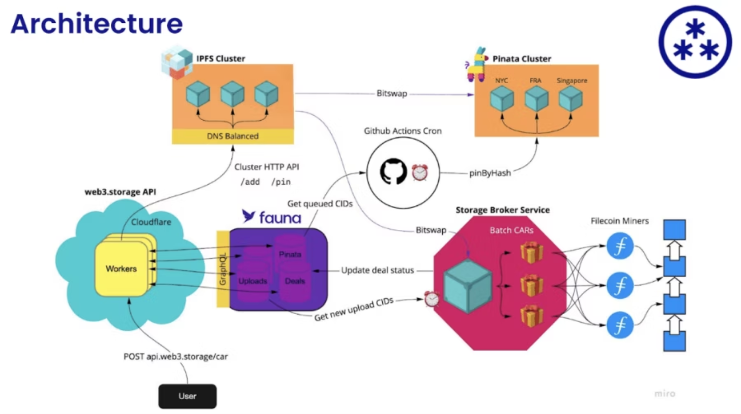
Some Other Components in Filecoin:
Market Settlement & Autonomic Repair
At every protocol epoch, the Network's Manage Protocol: Monitors all active storage and retrieval deals in the orderbooks.
Shared Data Structures & Transparency
On-chain and off-chain sets tracking all open, matched, or completed orders.
Client and Miner Autonomy, Privacy, and Flexibility:
Architecture and Components in Filecoin distributed system
All data is encrypted end-to-end by Clients; Miners cannot decrypt or misuse content.

Slide 10

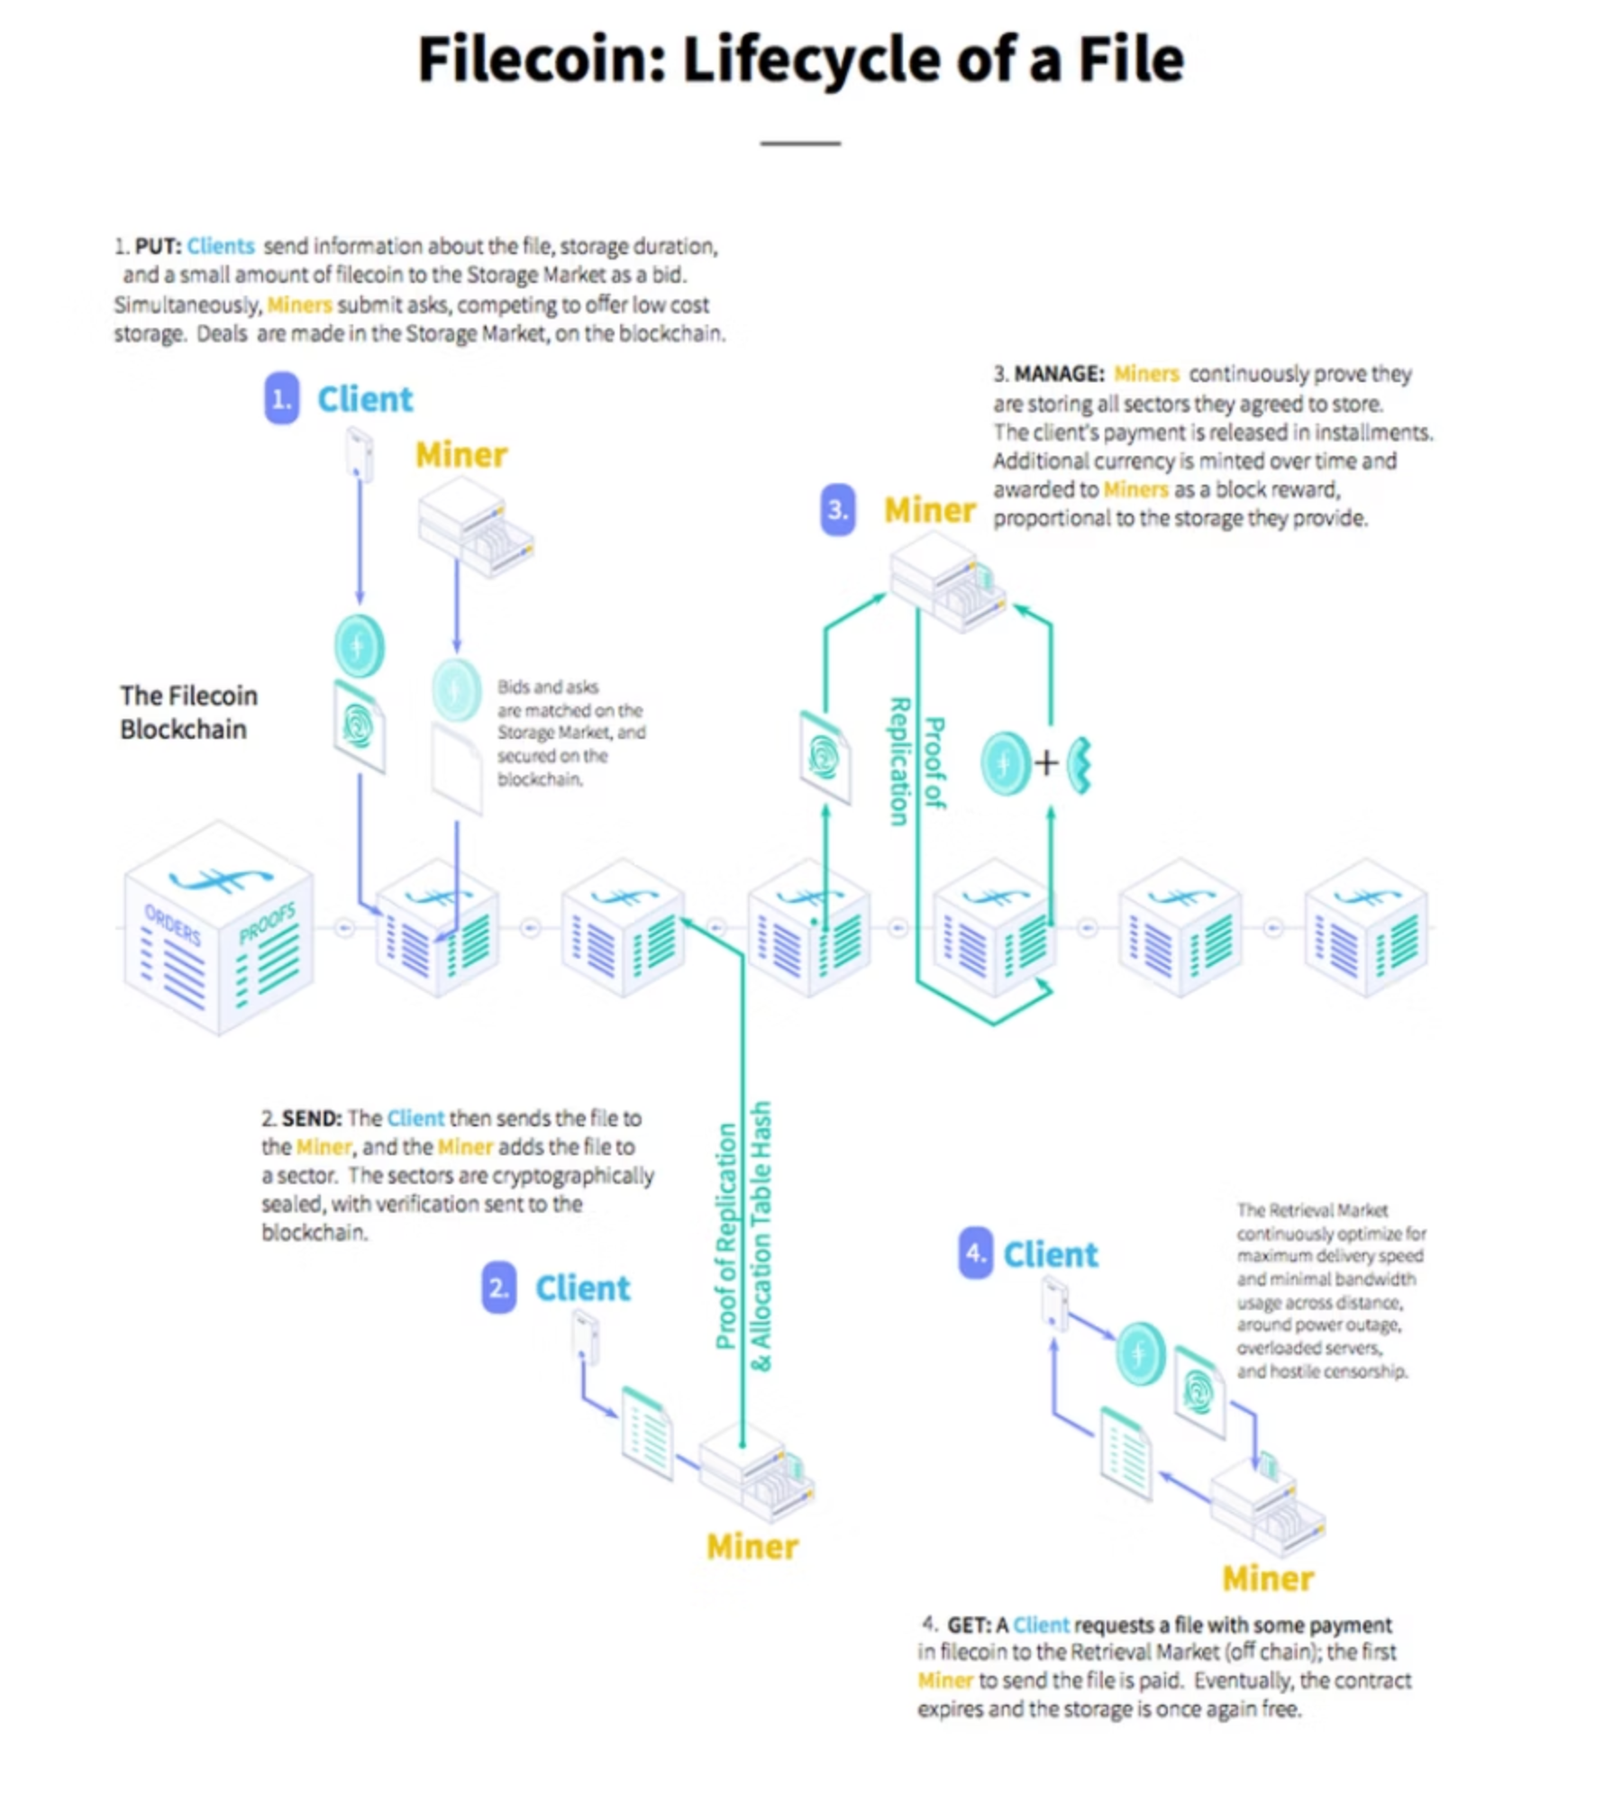
How Data is Organized
File System Design
Filecoin employs a robust file system design to ensure data integrity and availability:
Data Organization: Files are broken into pieces, which are then sealed into sectors for storage by miners. Allocation tables track data distribution.
Access Methods: Simple Put/Get operations, similar to traditional file systems, but decentralized.
Encryption: Data is encrypted end-to-end for privacy and security.
Fault Tolerance & Scalability: Achieved through data replication across multiple miners and distributed architecture.
Hot/Cold Storage: Supports both high-speed retrieval (hot) and archival storage (cold) needs.

Slide 11






What Filecoin Offers
Comprehensive Services
Storage & Retrieval
Client-Side Caching
Primary service for decentralized data storage and access.
Enhances retrieval speeds for frequently accessed data.
Replication & Self-Healing
Distributed Namespace
Automatic data duplication and repair for resilience.
Global, unique identifiers for stored data.
Authentication
Economic Security
Cryptographic methods ensure secure user and data verification.
Incentive mechanisms protect against malicious behavior.

Slide 12

Balancing Strengths and Challenges
Advantages & Disadvantages
Advantages
Disadvantages
Scalability: Elastic and global storage capacity.
Complexity: Technical challenges for new users/miners.
Verifiability: Cryptographic proofs ensure data integrity.
Latency: Initial retrieval can be slower than centralized services.
Incentive Compatibility: Economic model aligns participant interests.
Resource Demands: Significant hardware and bandwidth for miners.
Decentralization: No single point of failure or control.
Adoption Barriers: Integration with existing systems.

Slide 13
Evolving Landscape
Future Directions & Ecosystem Role
Filecoin is constantly evolving, with significant developments underway:
Filecoin Virtual Machine (FVM): Enables smart contracts and DApps on Filecoin.
Zero-Knowledge Proofs (ZK proofs): Enhancing privacy and efficiency.
Challenges: Improving user experience, optimizing retrieval, and fostering wider adoption.
It plays a unique role alongside alternatives:
Alternatives: Arweave (permanent storage), Storj (decentralized cloud), Sia (p2p storage), IPFS (content-addressed network), BTFS (BitTorrent File System).
Ecosystem Role: Filecoin complements IPFS by providing a persistent, incentivized storage layer, critical for the long-term vision of Web3.

Slide 14
The Path Forward: Decentralized Storage Landscape
Understanding the diverse approaches to decentralized storage is crucial for appreciating Filecoin's unique position and future potential. This table compares key distributed file systems:
System
Primary Focus
Incentive Mechanism
Data Durability/Redundancy
Key Differentiator
Filecoin
Decentralized Data Storage
FIL (Storage/Retrieval payments, miner collateral)
Proof-of-Replication, Proof-of-Spacetime, Sector sealing
Verifiable storage with active economic incentives
Arweave
Permanent & Perpetual Storage
AR (One-time payment for permanent data)
"Blockweave" (data replicated across all miners)
Truly permanent, "pay once, store forever" model
Storj
Decentralized Cloud Storage
STORJ (Payments for storage/bandwidth)
Erasure coding, encrypted shards across nodes
Enterprise-grade, highly distributed, developer-friendly
Sia
Peer-to-Peer Storage Marketplace
Siacoin (Contracts between users & hosts)
Erasure coding, direct host-client contracts
Direct peer-to-peer relationships, private by design
Each system offers distinct advantages, catering to different needs within the broader decentralized web ecosystem. Filecoin stands out for its robust verifiability and market-driven incentives for storage providers.

Slide 15
The Path Forward
Conclusion & Outlook
Filecoin is more than just a storage solution; it's a critical infrastructure for the decentralized future.
01
02
03
Relevance to Web3
Long-Term Influence
Integration with Emerging Technologies
Enables data ownership, censorship resistance, and foundational layer for decentralized applications.
Reshaping how data is stored, accessed, and secured globally, fostering data freedom.
Synergies with AI, IoT, and metaverse for robust, scalable data backbones.
Filecoin continues to pave the way for a more open, transparent, and resilient internet.

